Slide 1

EVENTZO

Slide 2

INTRODUCTION:
The aim of this application is to provide an interactive environment among students of various colleges providing updates regarding different events or activities.
It creates an open forum and brings together all the students of similar age groups providing a space for communication and enables the sharing of knowledge and ideas.
This application can become a one-stop for the various needs of students.

Slide 3
PROBLEM DEFINITION:
Many events, activities, technical and cultural fests that take place in colleges are not well noticed by students of other colleges.
Details of the events are not reached to the students due to lack of communication.
There are many other applications available to communicate only within their colleges but other college students are not aware of the events .
Communication of these events requires physical effort to reach out to different colleges and convey the information regarding such events.

Slide 4
Modules Involved:
1. User Registration:
When user will open the URL of website, GUI should popup for registration.
GUI will include the basic information about user such as: User Name, E-mail ID,Address, Contact number, Password, City,State, Country etc.
All information related to the user, which he/she has entered into the GUI, should store into the relational database.

Slide 5
2.User Login:
User-ID should be unique into the database.
If a user enters wrong information, it should give an alert or, popup for wrong inputs.
After successful login users should redirect to the home page.

Slide 6
3.Uploading the Poster:
User can upload a event poster they needed and an option called “SUBMIT” is mandatory for the confirmation.

Slide 7
4.Comment Session:
This feature is used to gain information from the user regarding the cons and flaws in the website.

Slide 8
5.View Poster:
The Event Poster can be viewed by Department wise like CSE,EEE,ECE,IT,FT which was uploaded by the event manager.

Slide 9
6.Download :
This feature allow admin
And student to download the poster so that he can avoid the fake order.

Slide 10
7.Home Page GUI Design:
Additional features such as, company name,
logo, tool assumptions etc. shall be
required.

Slide 11
8. User Logout:
Only if user is login into the website, then logout tool/button should be visible otherwise it shall be void.

Slide 12
Software Requirements:
Operating system -we have chosen operating system for its best support .
Database-we have chosen SQL database and PHP to save user details,events poster .
HTML-To implement the project we have chosen HTML language for its interactive support

Slide 13
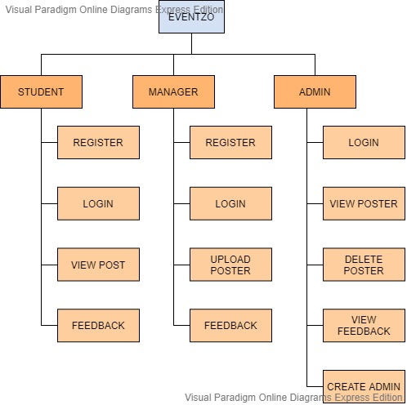

Slide 14
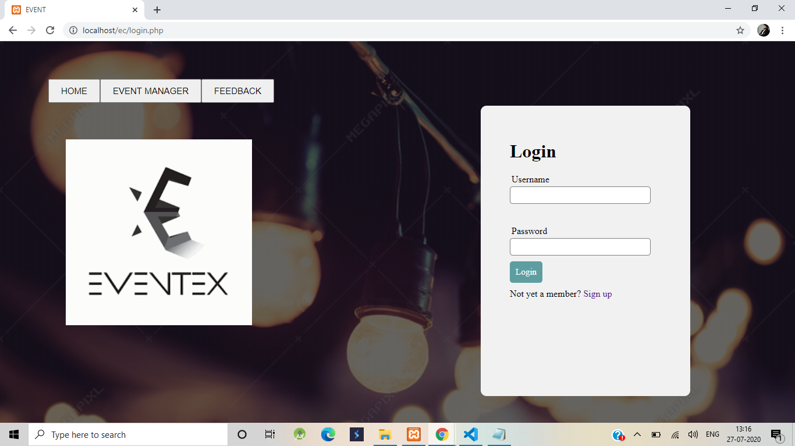
Home page

Slide 15
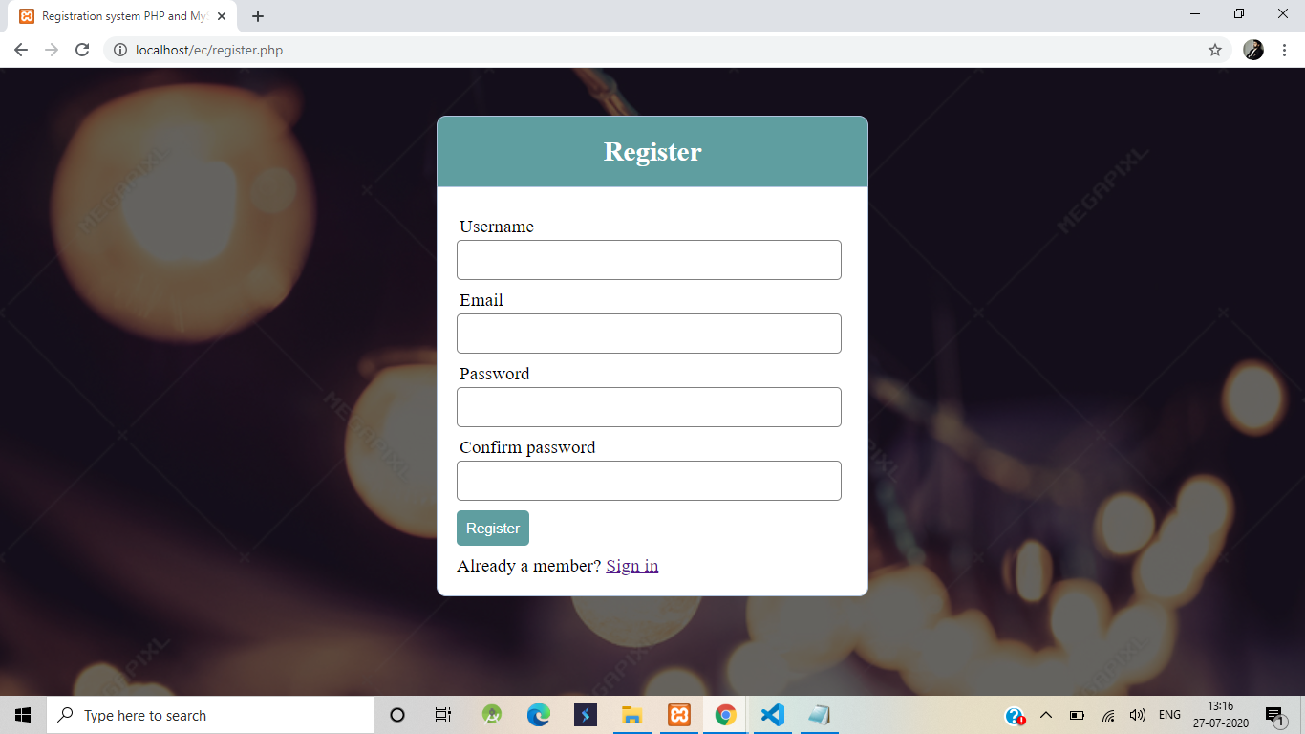
User registration Form :

Slide 16
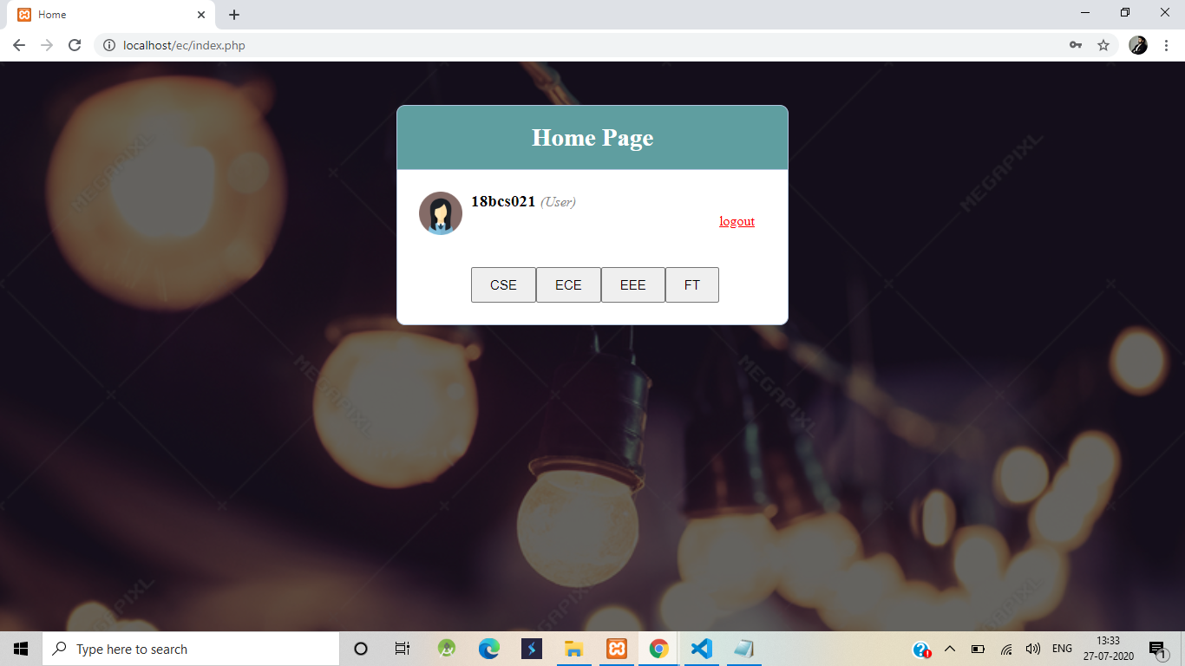

Slide 17
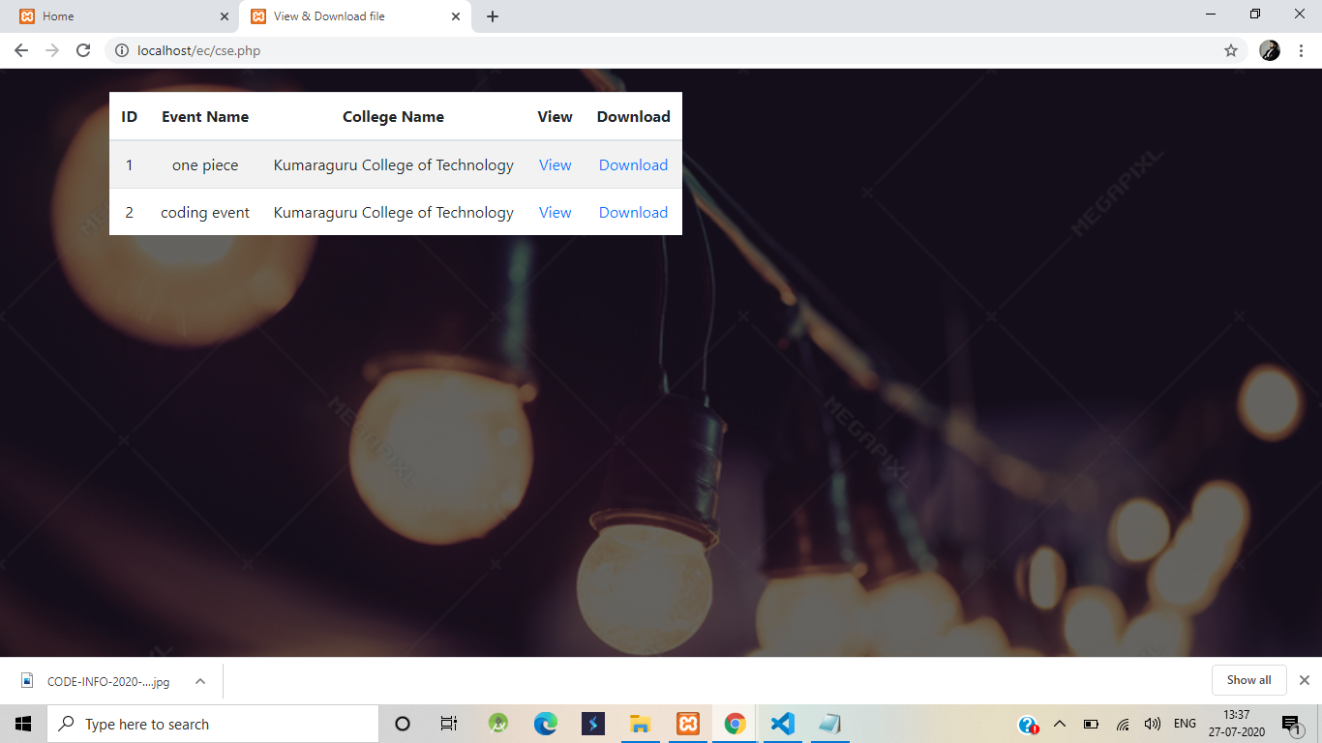

Slide 18
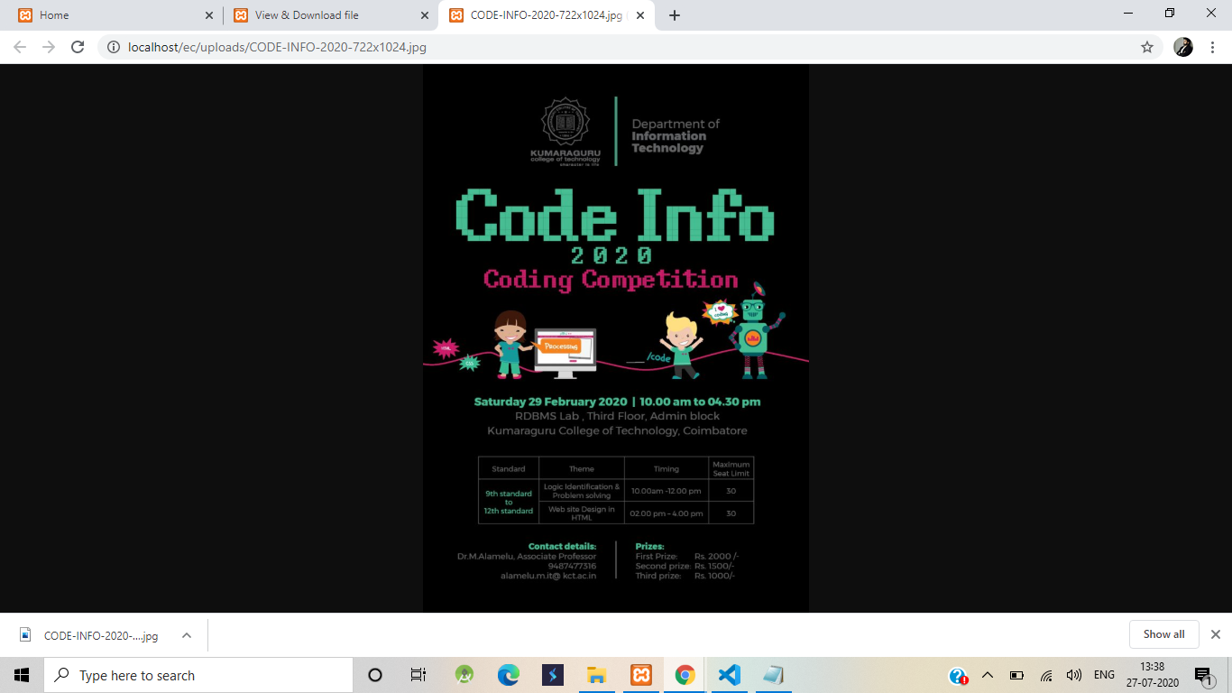

Slide 19
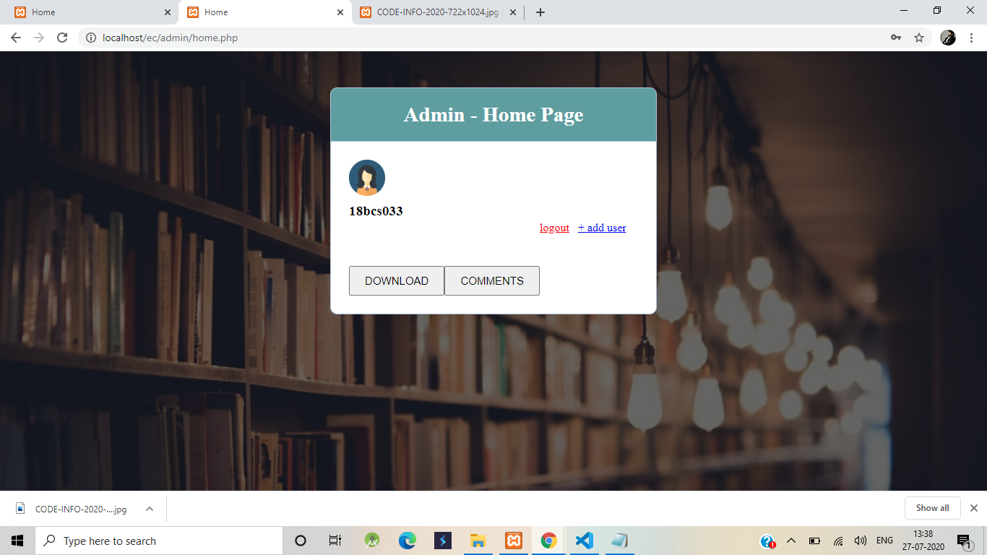

Slide 20
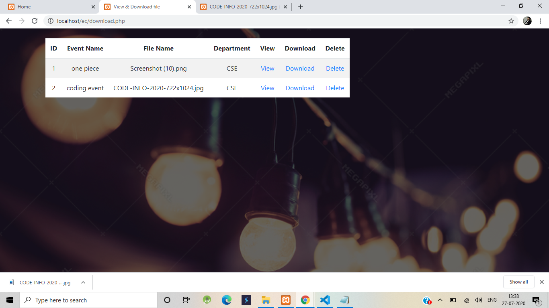

Slide 21
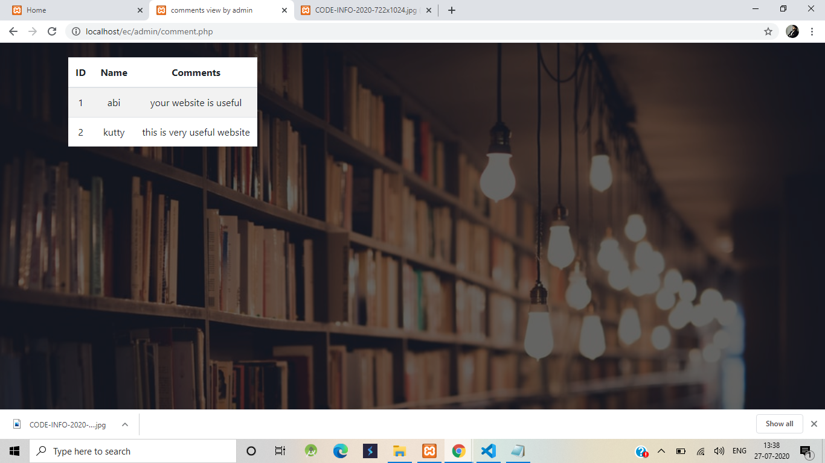

Slide 22
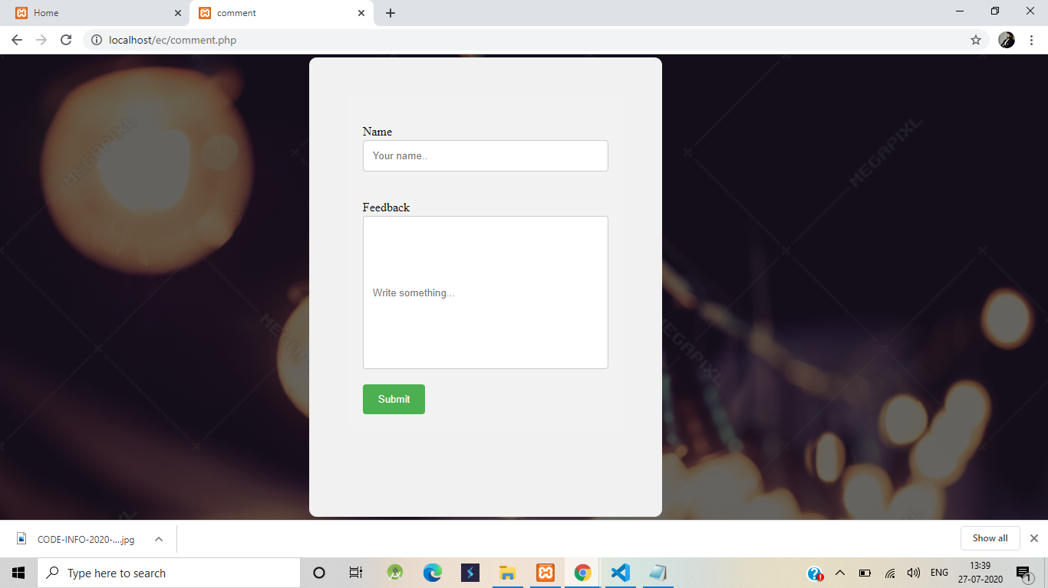

Slide 23
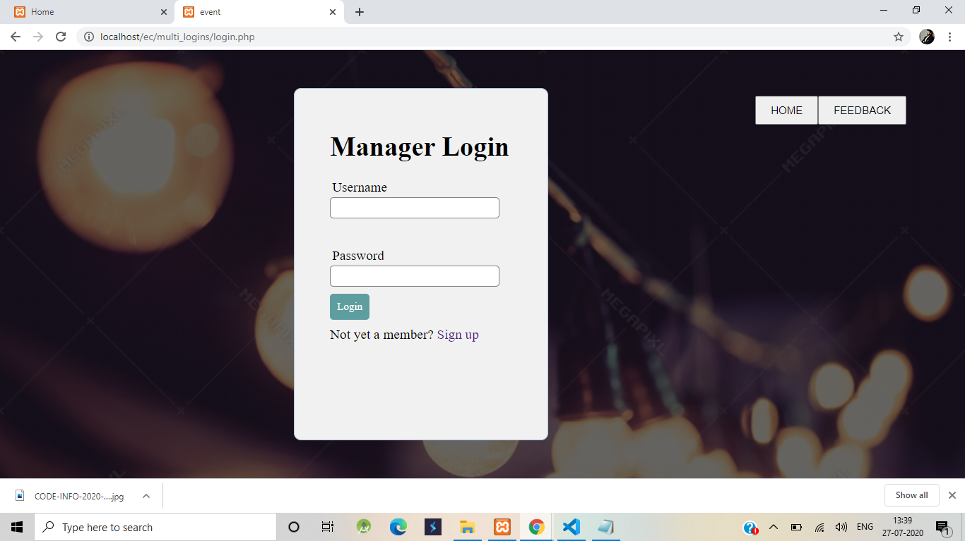

Slide 24
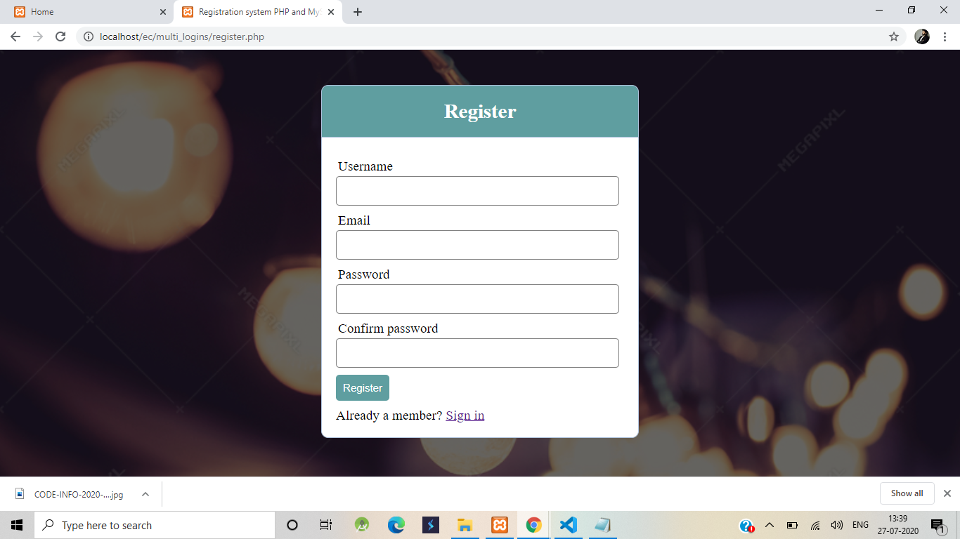

Slide 25
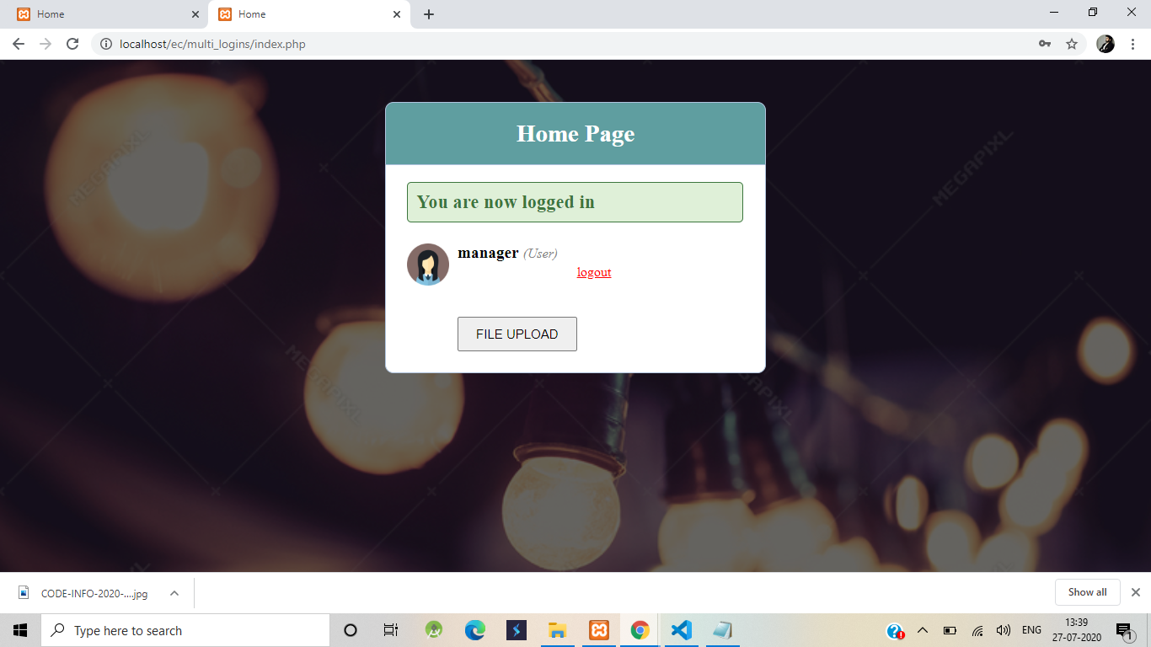

Slide 26
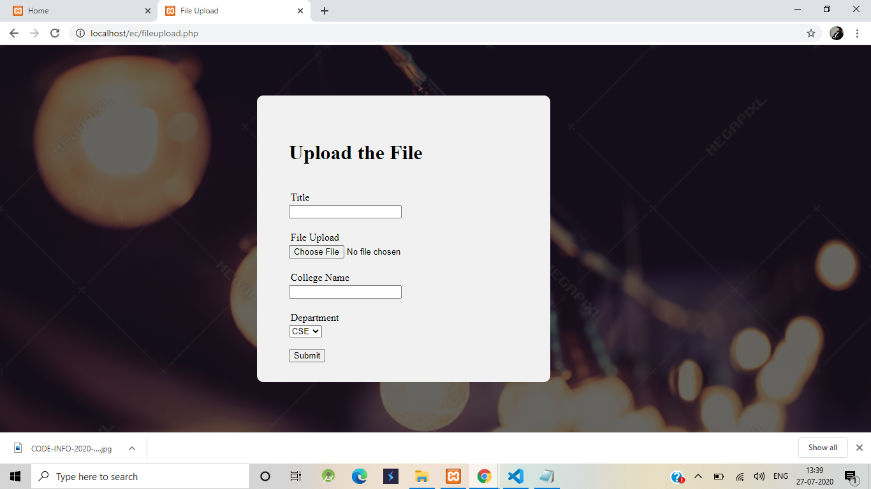

Slide 27
LITERATURE SURVEY:
In existing college applications,the students can get knowledge about big events conducted in the colleges while the intercollege events are not reached .
There are application available to share information about the events and data through notes
Information are shared through posters ,web browser etc..

Slide 28
Con’s of existing system :
Need of various application for various needs.
New applications need to be published for every new events .
There is no common event communication platform to share the event details.
The reach is less.
Not efficient

Slide 29
Proposed application:
The Eventzo application brings the solution for the above problem by establishing the effective communication among all students .
It can also enable communication between lecturers and students to share knowledge and concepts through this application.

Slide 30
Pro’s of our proposed application:
Makes communication easier
The information about events can be reached effectively
Communication of these events does not requires physical effort to reach out to different colleges.
Easy to use and reliable .
Efficient to access.

Slide 31
Presented by:
S.Miruthuvikasini 18BCS021
N.Abinayasri 18BCS033
R.Pragathi 18BCS038
N.Jenfero 18BCS043
P.Lashya 18BCS045
R.R.Bhrami 18BCS056

Slide 32
THANK YOU.

